Slide 1
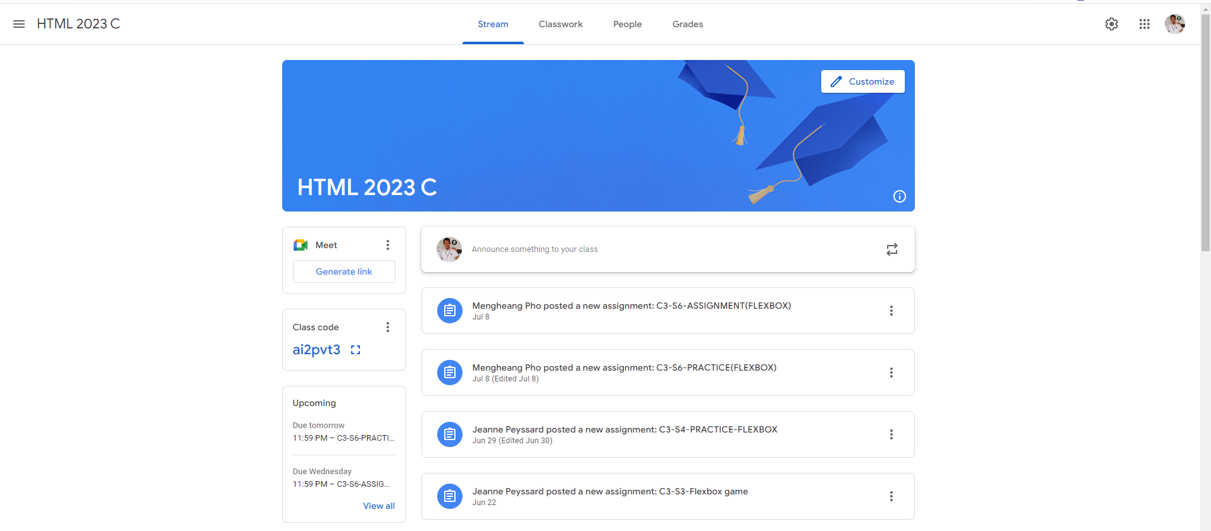
Identify root components of website below

Slide 2
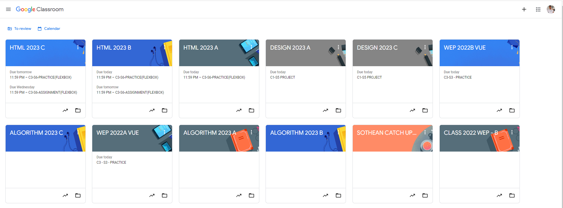
Root div
- Height: 100vh
content
nav
Flex: 0
header
Flex: 0
Flex: 1

Slide 3
Answer
As we can see in the example picture below, we can divide it into 3 section. We can see the navigation section at the top and header and content to be arrange respectfully under the section navigation.
content
Navigation
Flex: 0
header
Flex: 0
Flex: 1

Slide 4
At the navigation section, we can divide it into sub containers:
Flex 1
Flex 2
Flex 1
Navigation-Left
Navigation-center
Navigation-Right

Slide 5
And we can see header of the example does not divide into any sub container.
content
header

Slide 6
We can see that the content are divide into 2 sub containers, including the main content on the left and the sidebar content on the right.
Flex 0
Flex 1
Main-sidebar
Main-content

Slide 7
Last but not least, we can define each content such as the post:
Post-Date
Post-Title

